Slide 1
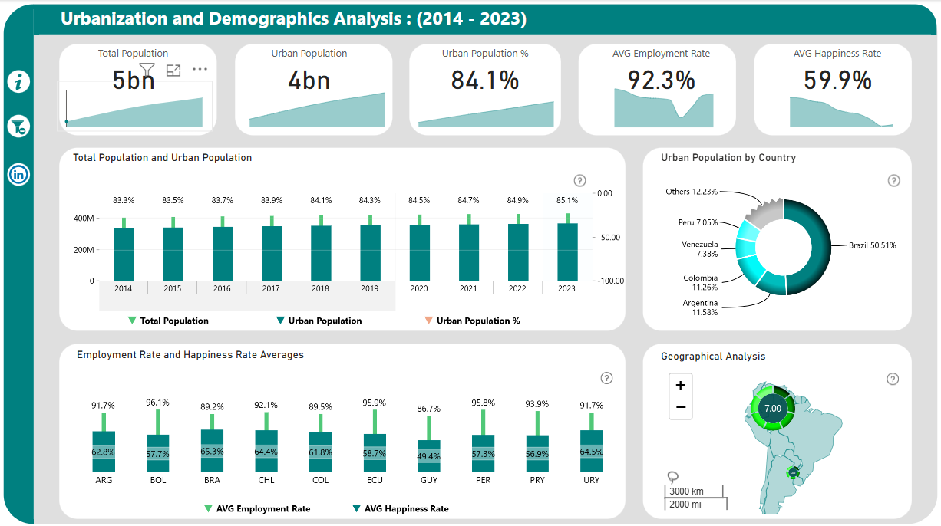
10-Year Urbanization Trends
Clear Filter
These graphs display trends over time.
Join us on LinkedIn
Hover over the points to see more details about Total And Urban Population.
Zoom in and out to explore geographical data and click on pie chart segments to view detailed country-specific information.
Click here to drill down into the Income Group and explore the countries within it.

